Slide 1

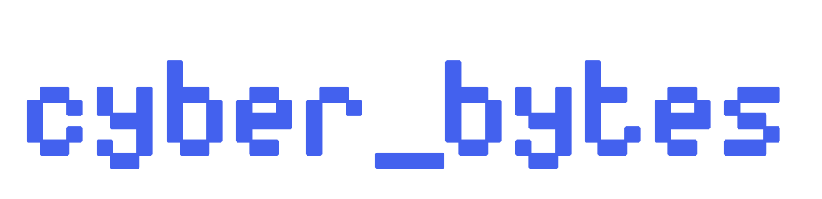

TECHNOLOGY-FACILITATED VIOLENCE
DIGITAL HARMS AND ONLINE VULNERABILITIES

Slide 2

BACKGROUND:
PhD Candidate and Instructor (Communication Studies) at McMaster University – I teach courses about tech, society & culture.
Researching how digital platforms perpetuate gendered and sexuality-based digital harms
Published the “Challenging Gendered Digital Harm Research Report” with the Canadian Women’s Foundation
Participated in UN dialogues (Commission on the Status of Women) about gender equity and digital rights, shaped online harms policy recommendations and supported community organizations working on digital safety and justice

Slide 3
WHAT WOULD A SAFE DIGITAL SPACE FEEL LIKE TO YOU?

Slide 4
TFGBV IS THE USE OF TECHNOLOGY TO HARM, HARASS OR ABUSE PEOPLE BASED ON GENDER, GENDER EXPRESSION, GENDER IDENTITY OR PERCEIVED GENDER.
In other words, it’s gender-based violence that’s done using technology.
Digital harm is prevalent:
“Almost 2 in 3 women globally have been subjected to TFGBV. Globally, 85% of women have witnessed online violence being committed against another woman” (United Nations Population Fund, 2025).
“61% of women and gender-diverse people in Canada have experienced gendered digital harm.” (Canadian Women’s Foundation, 2025).
“Across Canada, more than 1 in 4 young women and gender diverse youth have been personally targeted by online hate.” (YWCA, 2022).

Slide 5
(SOME) FORMS OF TFGBV:
Online harassment: Harming someone by sending threats, insults, or abusive messages online.
Doxxing: Revealing or publishing private or identifying information without consent to intimidate, harass or cause harm (including to one’s credibility or reputation).
Non-Consensual Distribution of Intimate Images (NCDII): Sharing or threatening to share sexual or intimate photos/videos without someone’s consent, including ‘revenge porn’.
Deepfakes: Digitally manipulated media that uses artificial intelligence to replicate someone’s likeness that can be used to spread misinformation and create fake sexual content.
Online Stalking and Surveillance: Using digital tools to monitor or track someone (online or offline) without their consent.
Impersonation: Impersonating someone online — such as by creating fake profiles — to harass, exploit, damage reputations, or deceive others for financial gain.

Slide 6
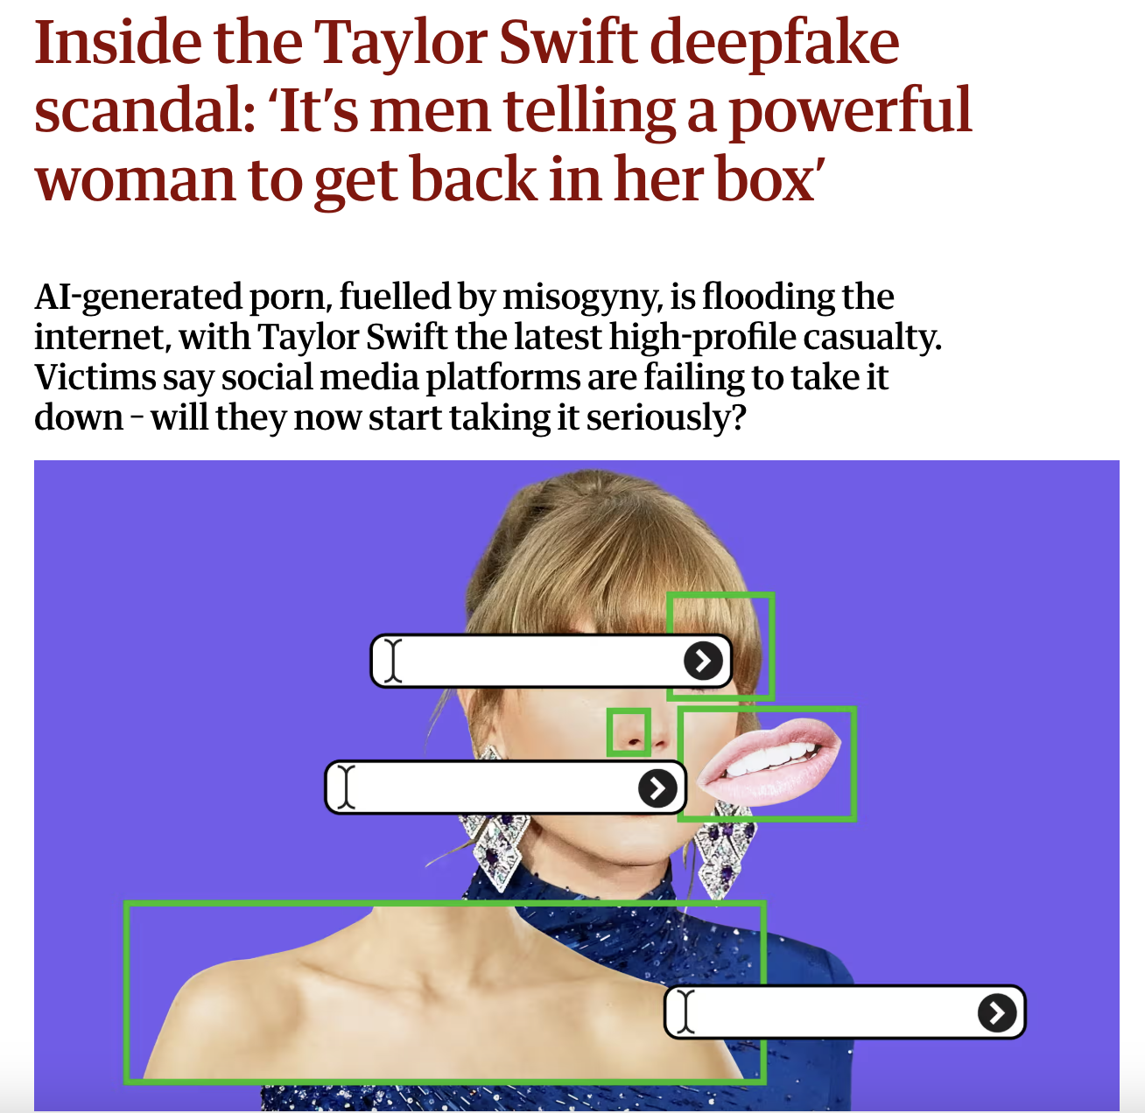
DEEPFAKES

Slide 7
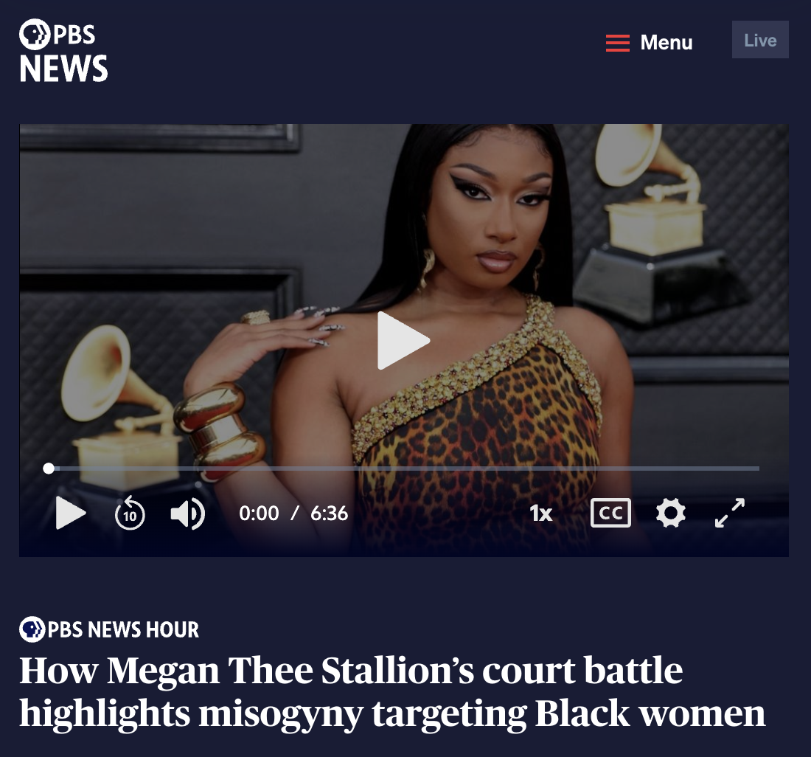
ONLINE HARASSMENT

Slide 8
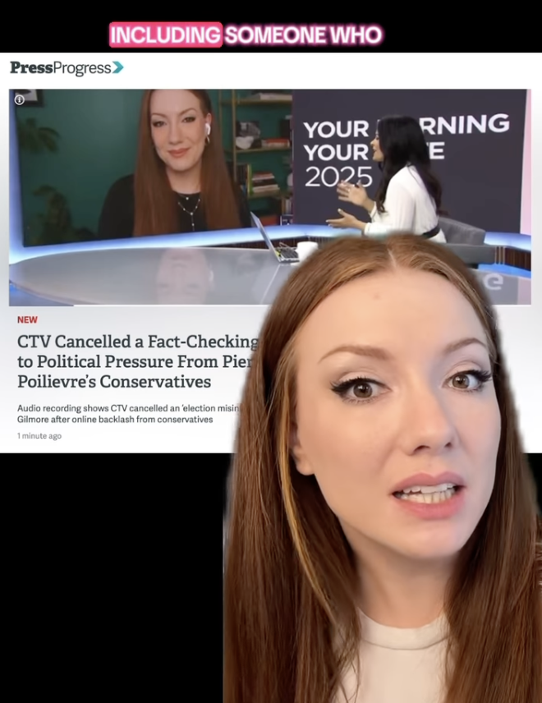
TARGETED
HARASSMENT CAMPAIGNS

Slide 9
TFGBV IS NOT EXPERIENCED EQUALLY.
Disproportionately affects cis and trans women, trans men, non-binary, Two-Spirit, and other gender-diverse people — particularly those who are Black, Indigenous, people of colour, and/or people with disabilities.
While TFGBV is rooted in gender-based oppression, it often intersects with other forms of oppression like racism, sexism, ableism, transphobia and colonialism, which can compound one another, especially online.
This means that people experience harm in online spaces differently.

Slide 10
TFGBV is structural
Not everyone experiences TFGBV the same way
“Logging off” isn’t a solution
Online harm IS real harm
Solutions must be flexible and context-aware

Slide 11
DIGITAL SAFETY PLAN
Identify the online risks you face and which accounts feel unsafe.
Secure your accounts by using strong passwords and enabling two-factor authentication.
Limit what personal information you share publicly and adjust your privacy settings.
Save evidence of any abuse, like screenshots and messages, in a safe place.
Report harmful behavior on the platforms you use.
Build a support network and reach out to trusted people when you need help like family, friends and allies.
Know your rights and seek legal advice if harassment escalates.

