Slide 1
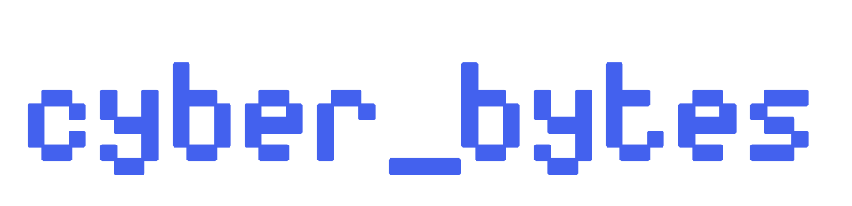
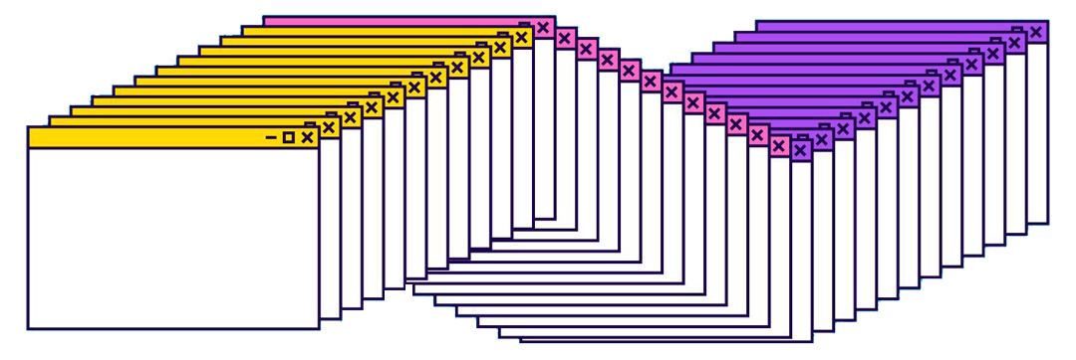
DIGITAL
A RESOURCE GUIDE BY AMIRA DHALLA
SAFETY 101

Slide 2
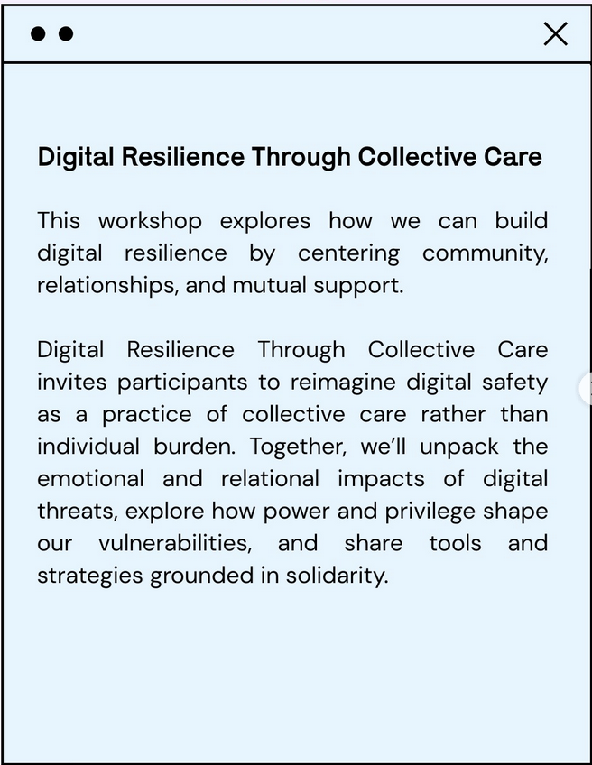
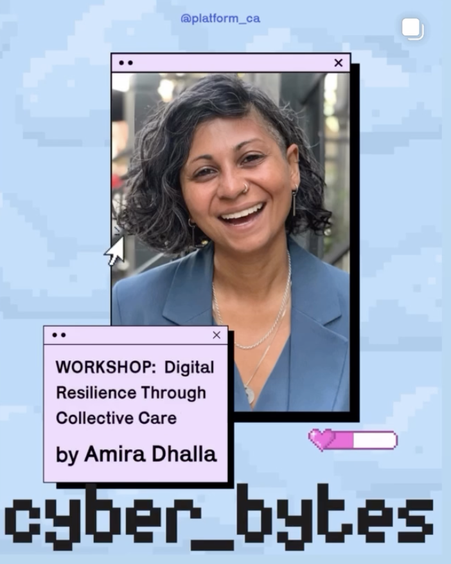

Slide 3
TODAY’S CONTAINER
We’re here to (collaboratively) learn!
We represent ourselves, but bring along perspectives from our ancestors, communities, and movements we are part of
We’re in a moment of turbulence

Slide 4
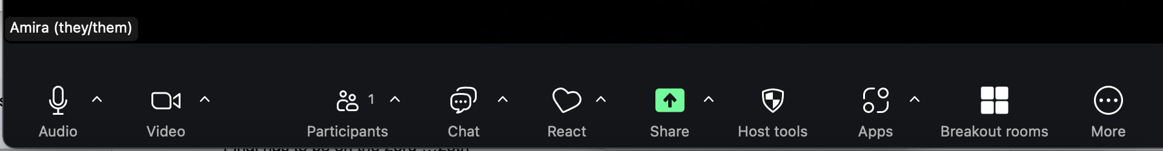
ZOOM NAVIGATION
We will be using:
  Audio
  Chat
  Polls
  Reactions
  Breakout Rooms

Slide 5
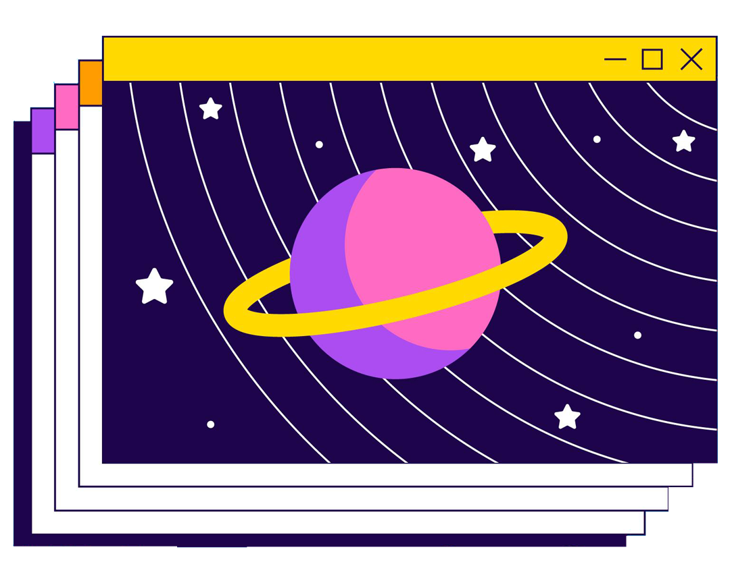
True // False // Sure?
(When a statement pops up on your screen, click the answer that best resonates. Answer as honestly as you can, we won’t record or identify individual responses)
✅
❌
⁉️

Slide 6
Community is important to me

Slide 7
I think about how my actions impact others around me

Slide 8
I understand the importance of collective care

Slide 9
I use digital security tools and services to protect myself online

Slide 10
I know how my digital security impacts those around me

Slide 11
I understand how technology is used against communities I care about

Slide 12
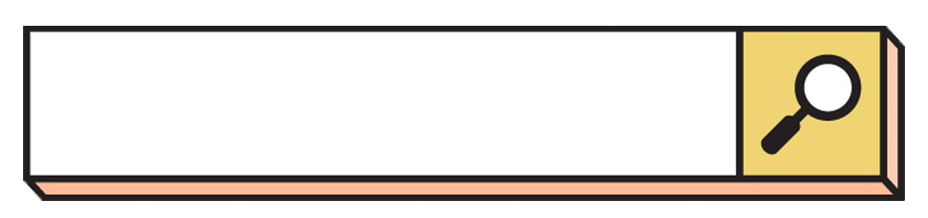

Why are we here?
The People’s Digital Defense is re-imagining the role of care and community in digital security.

Slide 13
WE KEEP US SAFE

Slide 14
Question
What does it mean to keep us safe among digital systems?

Slide 15
Community is important to me | ✅ | I use digital security tools and services to protect myself online
I think about how my actions impact others around me | ✅ | I know how my digital security impacts those around me
I understand the importance of collective care | ✅ | I understand how technology is used against communities I care about
⁉️
❌
⁉️

Slide 16
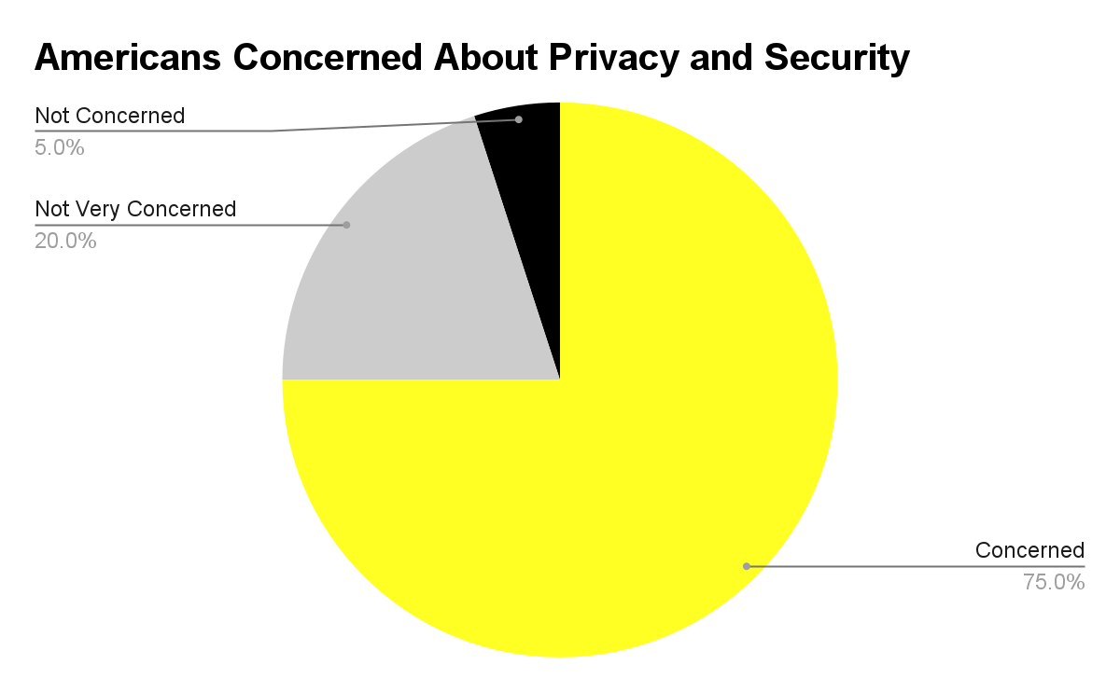
June 2022 Consumer Reports nationally representative American Experiences Survey of 2,103 US adults.

Slide 17
THREAT
THREAT
THREAT
Black and Latino Americans who experienced a cyber attack are twice as likely to lose money compared to white Americans
-Consumer Cyber Readiness Report
Security forces employ digital targeting as a means of gathering or creating digital evidence to support prosecutions against LGBT people
-Human Rights Watch Report
Research shows threat actors are more likely to target immigrants or non-English speakers than other demographics
-BMC Public Health

Slide 18
Privacy and Security threats reflect systemic injustices and have emotional, physical, and economic impact on vulnerable communities

Slide 19
Every move we make online is a data point and our data leads to every person we interact with digitally.
🚨 Corporations and governments are keen to have this information 🚨

Slide 20
What do we do?

Slide 21
Shouting ‘self-care’ at people who actually need community care is how we fail people
Nakita Valerio

Slide 22
Digital Security Collective Care
🤝

Slide 23
COMMUNICATION
Use secure, encrypted messaging platforms like Signal and set disappearing messages
Adjust the security settings on the platforms you communicate on
Don’t use email for secure communications, and generally keep sensitive information from being written down
Establish digital security guidelines for those in your ‘group’
Delete or archive previous communication, material, or documents
Limit sharing of project/team on social media

Slide 24
PHYSICAL
Turn off location settings on devices
Remove facial recognition and biometric logins on mobile
Minimize recording or documentation of people (including in event sign-ups to recording at protests)
Don’t bring or minimize using your phone or turn it off in high-risk scenarios
Back-up your phone or delete sensitive information when traveling
Avoid standing out or being overtly identifiable

Slide 25
GENERAL SECURITY
Adjust and regularly review the settings on the apps (turn off location services, tracking, storage etc.)
Install updates when available
Use a password manager and create strong passwords
Use multi-factor authentication for our accounts
Decline cookies online
Opt-out of facial recognition
Delete unused accounts
Don’t click on suspicious links
Limit inputting sensitive info into AI systems

Slide 26
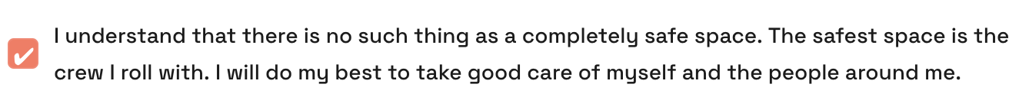
Source: House of Yes

Slide 27
Additional Resources

Slide 28
Surveillance Self Defense:
ssd.eff.org
Security Planner:
securityplanner.org
Activist Checklist:
activistchecklist.org

Slide 29
SCENARIO BREAKOUT
(Click the breakouts icon in the bottom of your Zoom window to join a room)

Slide 30
Anar recently joined a local organizing community and has decided to host a gathering for 30 friends to discuss the increase in surveillance cameras they see popping up in their neighborhood. They want to create a space to discuss how this impacts the neighborhood and what they can collectively do to keep each other safe. They consider themselves technically savvy but are not familiar with secure tools or what practices they should use.

Slide 31
Discussion Questions:
Is technically savvy the same as digital secure?
What tools should Anar use to organize and advertise the event?
What are the visible and invisible surveillance systems that the neighborhood should be aware of?
What are 3 actions the community can do to keep each other safe?

Slide 32
Anar recently joined a local organizing community and has decided to host a gathering for 30 friends to discuss the increase in surveillance cameras they see popping up in their neighborhood. They want to create a space to discuss how this impacts the neighborhood and what they can collectively do to keep each other safe. They consider themselves technically savvy but are not familiar with secure tools or what practices they should use.
Discussion Questions:
Is technically savvy the same as digital secure?
What tools should Anar use to organize and advertise the event?
What are the visible and invisible surveillance systems that the neighborhood should be aware of?
What are 3 actions the community can do to keep each other safe?

Slide 33
CLOSING
Thank You!
Reflections/Questions
Next Steps

Slide 34
Whether we want to admit it, whether we like it or not, we are all responsible for each other
Joél Leon

